Slide 1

Database Systems:
Design, Implementation, and Management
Ninth Edition
Chapter 14
Database Connectivity and Web Technologies

Slide 2
Objectives
In this chapter, you will learn:
About various database connectivity technologies
How Web-to-database middleware is used to integrate databases with the Internet
About Web browser plug-ins and extensions
What services are provided by Web application servers
Database Systems, 9th Edition

Slide 3
Objectives (cont’d.)
What Extensible Markup Language (XML) is and why it is important for Web database development
About SQL data services and how they can reduce the cost of data management
Database Systems, 9th Edition

Slide 4
Database Connectivity
Mechanisms by which application programs connect and communicate with data sources
  Also known as database middleware
Data repository:
  Also known as a data source
  Represents the data management application
    Used to store data generated by an application program
ODBC, OLE-DB, ADO.NET: the backbone of MS Universal Data Access (UDA) architecture
Database Systems, 9th Edition

Slide 5
Native SQL Connectivity
Connection interface provided by database vendors
  Unique to each vendor
Example: Oracle RDBMS
  Must install and configure Oracle’s SQL*Net interface in client computer
Interfaces optimized for particular vendor’s DBMS
  Maintenance is a burden for the programmer
Database Systems, 9th Edition

Slide 6
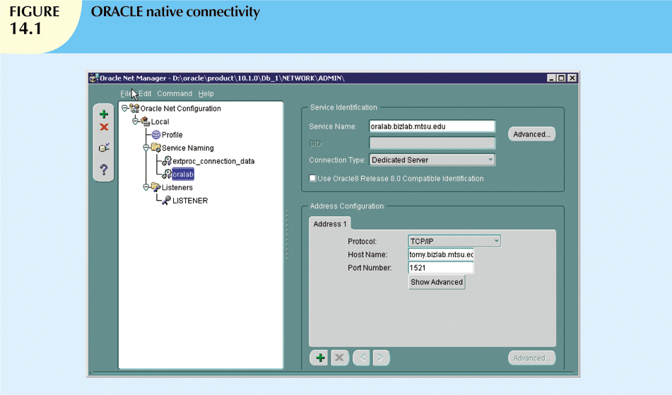
Database Systems, 9th Edition

Slide 7
ODBC, DAO, and RDO
Open Database Connectivity (ODBC)
  Microsoft’s implementation of a superset of SQL Access Group Call Level Interface (CLI)
  Widely supported database connectivity interface
  Any Windows application can access relational data sources
  Uses SQL via standard application programming interface (API)
Database Systems, 9th Edition

Slide 8
ODBC, DAO, and RDO (cont’d.)
Data Access Objects (DAO)
  Object-oriented API
    Accesses MS Access, MS FoxPro, and dBase databases from Visual Basic programs
  Provided an optimized interface that exposed functionality of Jet data engine to programmers
  DAO interface can also be used to access other relational style data sources
Database Systems, 9th Edition

Slide 9
ODBC, DAO, and RDO (cont’d.)
Remote Data Objects (RDO)
  Higher-level object-oriented application interface used to access remote database servers
  Uses lower-level DAO and ODBC for direct access to databases
  Optimized to deal with server-based databases, such as MS SQL Server, Oracle, and DB2
Implemented as shared code dynamically linked to Windows via dynamic-link libraries
Database Systems, 9th Edition

Slide 10
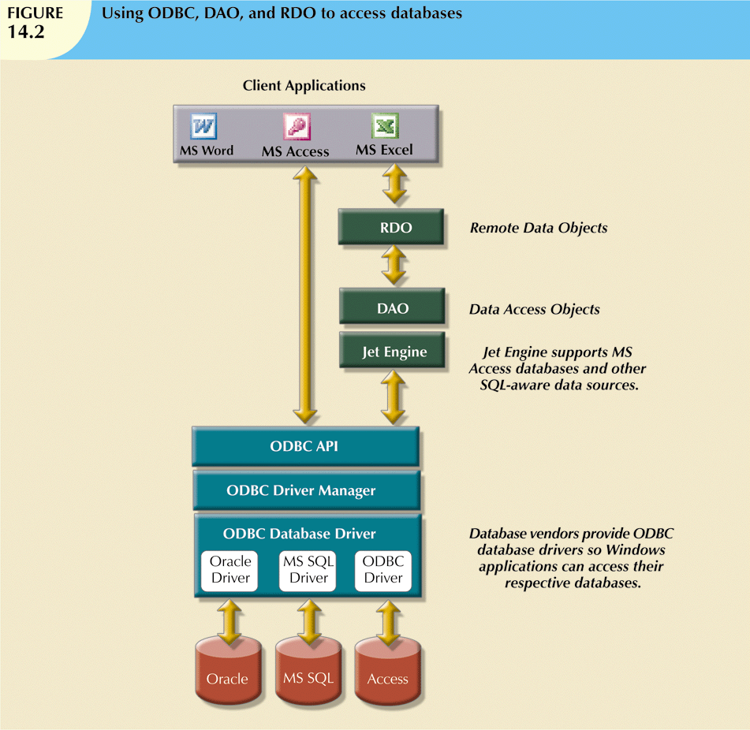
Database Systems, 9th Edition

Slide 11
ODBC, DAO, and RDO (cont’d.)
Basic ODBC architecture has three main components:
  High-level ODBC API through which application programs access ODBC functionality
  Driver manager that is in charge of managing all database connections
  ODBC driver that communicates directly to DBMS
Database Systems, 9th Edition

Slide 12
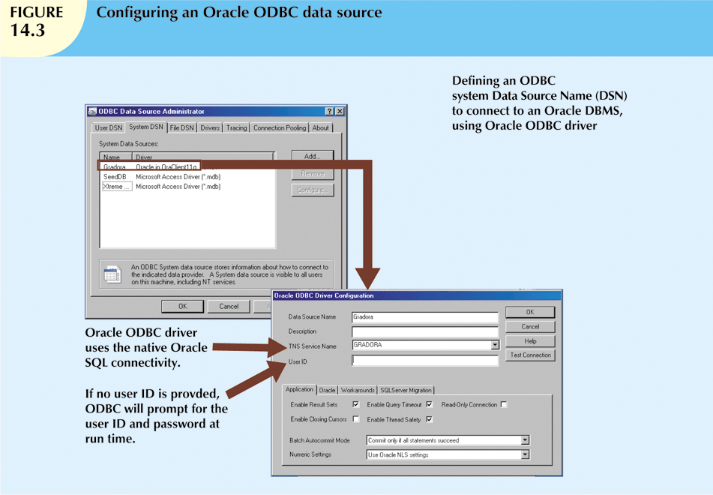
Database Systems, 9th Edition

Slide 13
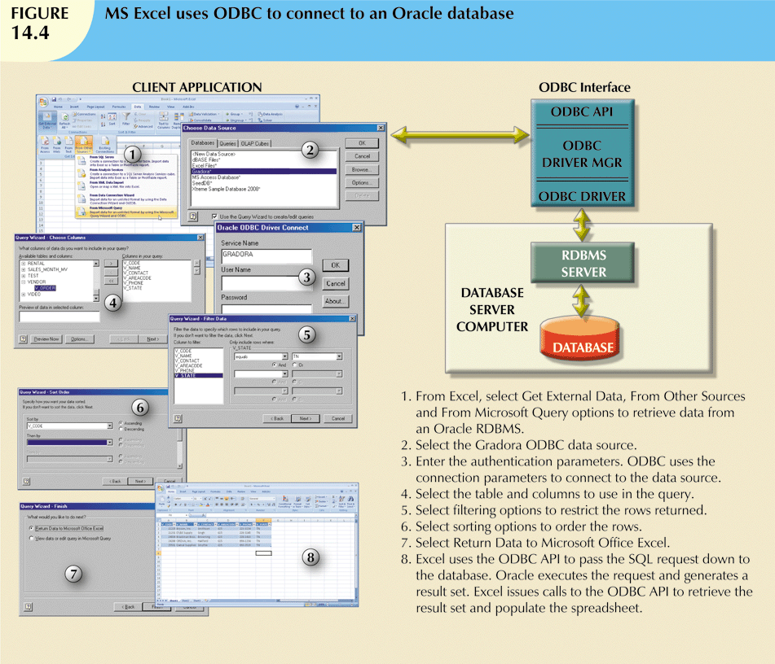
Database Systems, 9th Edition

Slide 14
OLE-DB
Object Linking and Embedding for Database
Database middleware that adds object-oriented functionality for access to data
Series of COM objects provides low-level database connectivity for applications
Functionality divided into two types of objects:
  Consumers
  Providers
Database Systems, 9th Edition

Slide 15
OLE-DB (cont’d.)
OLE-DB did not provide support for scripting languages
ActiveX Data Objects (ADO) provides high-level application-oriented interface to interact with OLE-DB, DAO, and RDO
ADO provides unified interface to access data from any programming language that uses the underlying OLE-DB objects
Database Systems, 9th Edition

Slide 16
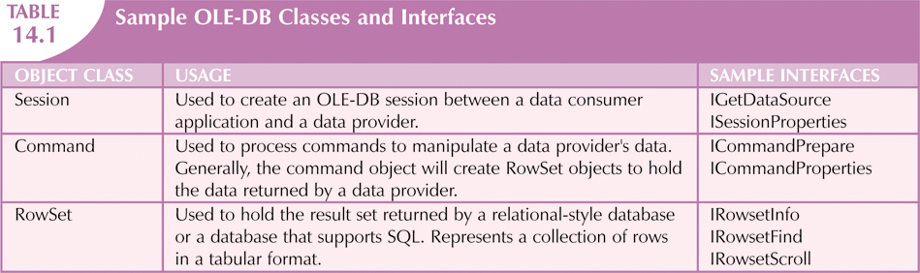
Database Systems, 9th Edition

Slide 17
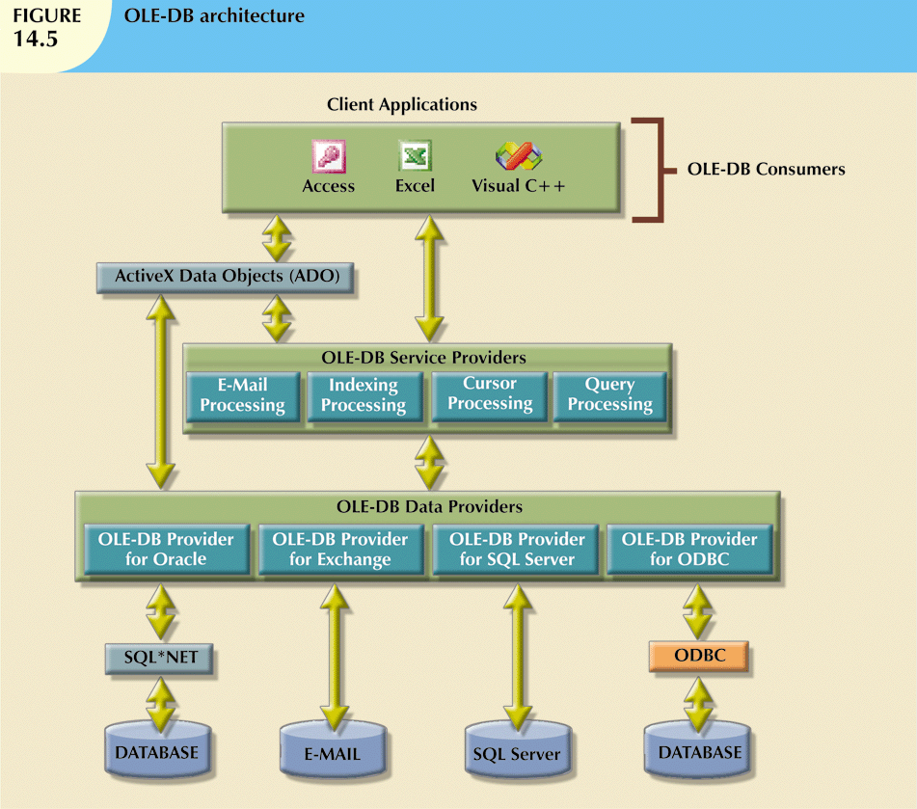
Database Systems, 9th Edition

Slide 18
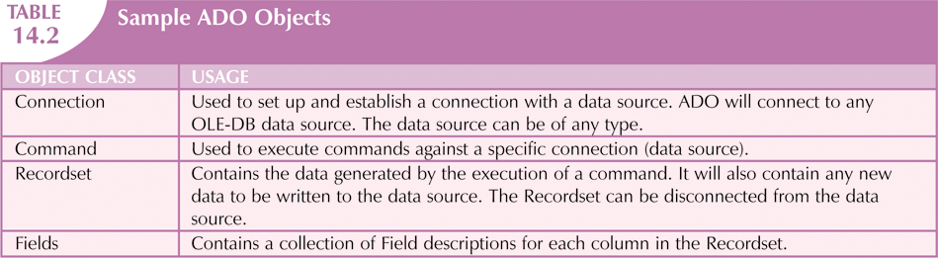
Database Systems, 9th Edition

Slide 19
ADO.NET
Data access component of Microsoft’s .NET application development framework
Two new features for development of distributed applications:
  DataSet is disconnected memory-resident representation of database
  DataSet is internally stored in XML format
    Data in DataSet made persistent as XML documents
Database Systems, 9th Edition

Slide 20
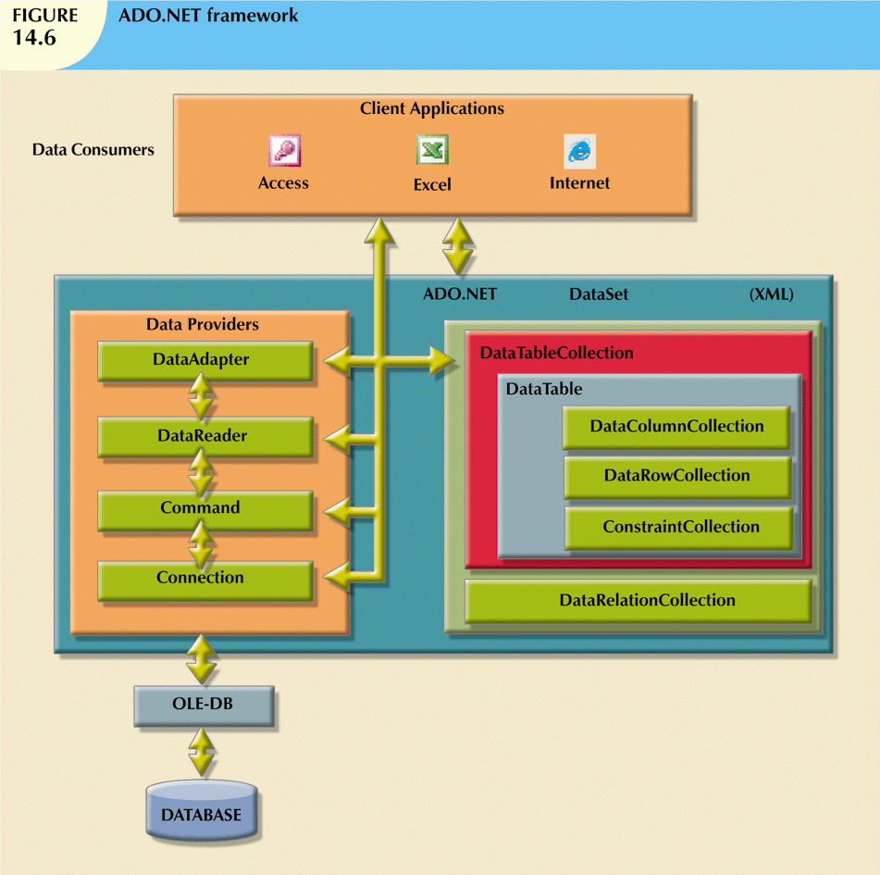
Database Systems, 9th Edition

Slide 21
ADO.NET (cont’d.)
Specific objects manipulate data in data source
  Connection
  Command
  DataReader
  DataAdapter
  DataSet
  DataTable
Database Systems, 9th Edition

Slide 22
Java Database Connectivity (JDBC)
Java is an object-oriented programming language
  Runs on top of Web browser software
Advantages of JDBC:
  Company can leverage existing technology and personnel training
  Allows direct access to database server or access via database middleware
  Provides a way to connect to databases through an ODBC driver
Database Systems, 9th Edition

Slide 23
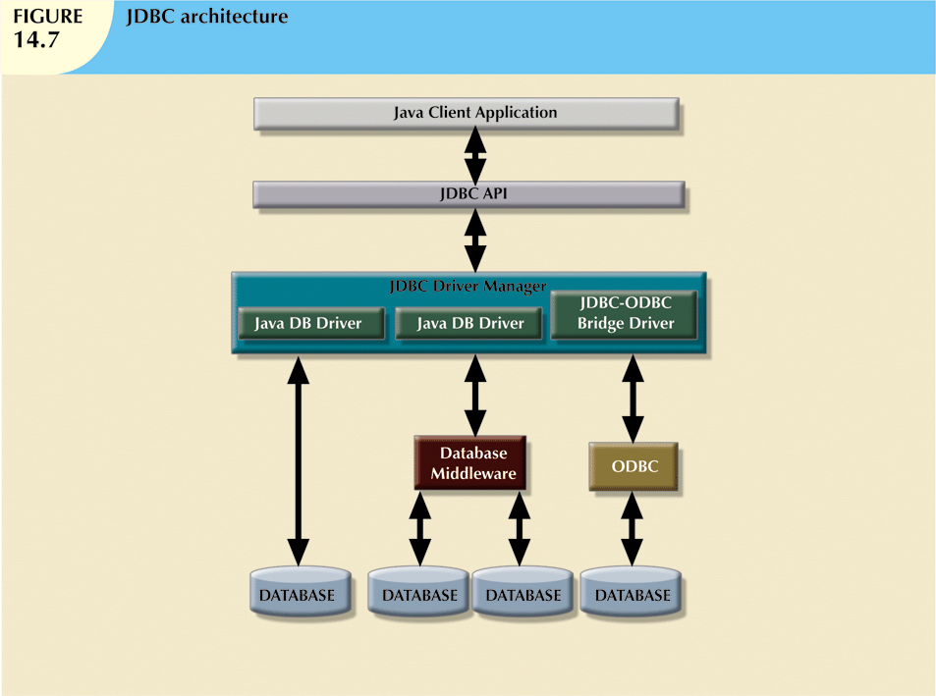
Database Systems, 9th Edition

Slide 24
Internet Databases
Web database connectivity allows new innovative services that:
  Permit rapid response by bringing new services and products to market quickly
  Increase customer satisfaction through creation of Web-based support services
  Yield fast and effective information dissemination through universal access
Database Systems, 9th Edition

Slide 25
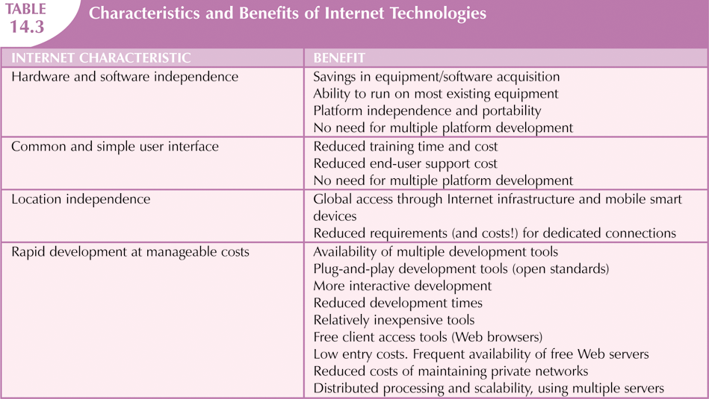
Database Systems, 9th Edition

Slide 26
Web-to-Database Middleware:
Server-Side Extensions
Web server is the main hub through which Internet services are accessed
Dynamic Web pages are at the heart of current generation Web sites
Server-side extension: a program that interacts directly with the Web server
  Also known as Web-to-database middleware
Middleware must be well integrated
Database Systems, 9th Edition

Slide 27
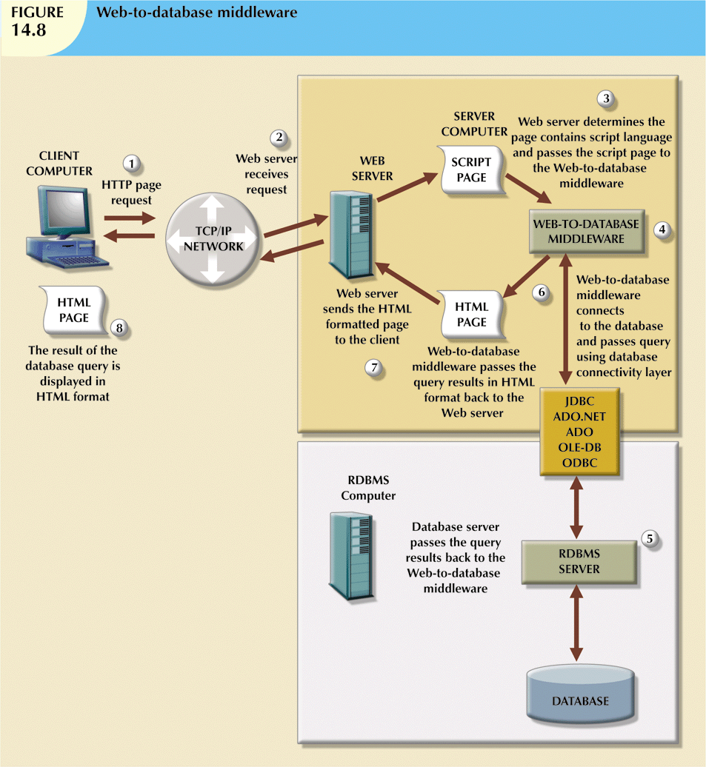
Database Systems, 9th Edition

Slide 28
Web Server Interfaces
Two well-defined Web server interfaces:
  Common Gateway Interface (CGI)
  Application Programming Interface (API)
Disadvantage of CGI scripts:
  Loading external script decreases system performance
  Language and method used to create script also decrease performance
API is more efficient than CGI
  API is treated as part of Web server program
Database Systems, 9th Edition

Slide 29
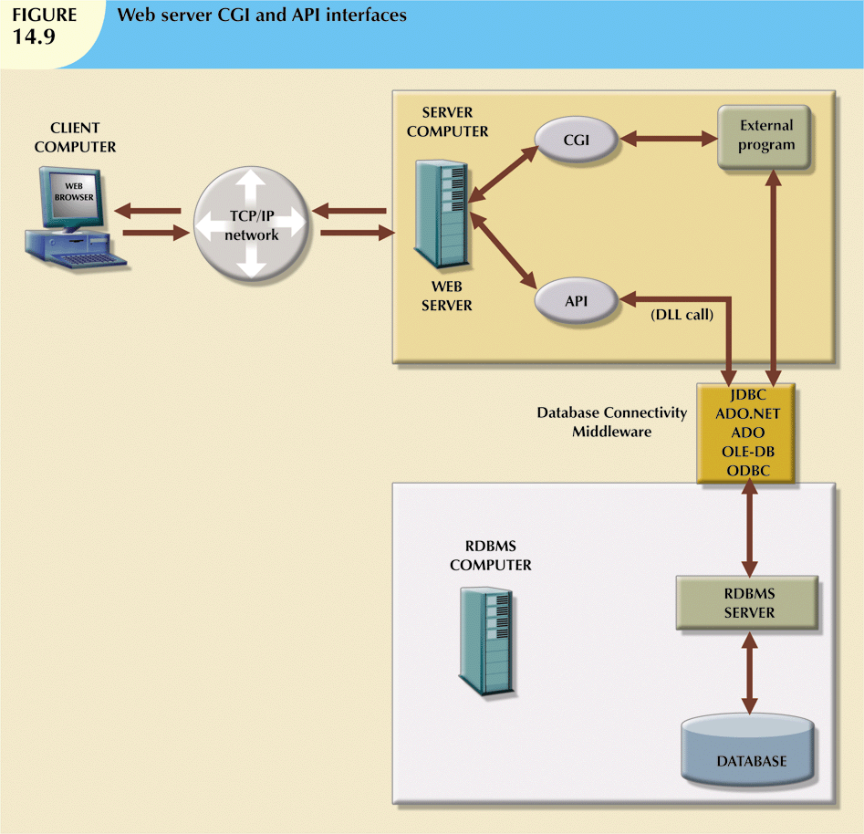
Database Systems, 9th Edition

Slide 30
The Web Browser
Software that lets users navigate the Web
Located in client computer
Interprets HTML code received from Web server
Presents different page components in standard way
Web is a stateless system: Web server does not know the status of any clients
Database Systems, 9th Edition

Slide 31
Client-Side Extensions
Add functionality to Web browser
Three general types:
  Plug-ins
  Java and JavaScript
  ActiveX and VBScript
Database Systems, 9th Edition

Slide 32
Client-Side Extensions (cont’d.)
Plug-in: an external application automatically invoked by the browser when needed
Java and JavaScript: embedded in Web page
  Downloaded with the Web page and activated by an event
ActiveX and VBScript: embedded in Web page
  Downloaded with page and activated by event
  Oriented to Windows applications
Database Systems, 9th Edition

Slide 33
Web Application Servers
Middleware application that expands the functionality of Web servers
  Links them to a wide range of services
Some uses of Web application servers:
  Connect to and query database from Web page
  Create dynamic Web search pages
  Enforce referential integrity
Some features of Web application servers:
  Security and user authentication
  Access to multiple services
Database Systems, 9th Edition

Slide 34
Extensible Markup Language (XML)
Companies use Internet to create new systems that integrate their data
  Increase efficiency and reduce costs
Electronic commerce enables organizations to market to millions of users
Most e-commerce transactions take place between businesses
HTML Web pages display in the browser
  Tags describe how something looks on the page
Database Systems, 9th Edition

Slide 35
Extensible Markup Language (XML) (cont’d.)
Extensible Markup Language (XML):
  Metalanguage to represent and manipulate data elements
  Facilitates exchange of structured documents over the Web
  Allows definition of new tags
    Case sensitive
    Must be well-formed and properly nested
    Comments indicated with <- and ->
    XML and xml prefixes reserved for XML tags only
Database Systems, 9th Edition

Slide 36
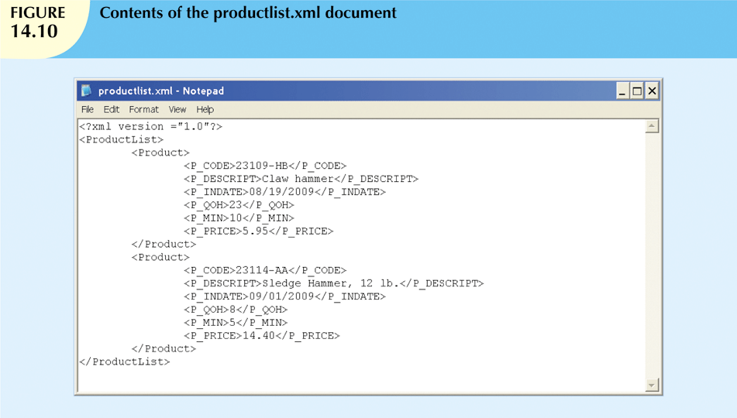
Database Systems, 9th Edition

Slide 37
Document Type Definitions (DTD) and XML Schemas
Document Type Definition (DTD)
  File with .dtd extension that describes elements
  Provides composition of database’s logical model
  Defines the syntax rules or valid tags for each type of XML document
Companies engaging in e-commerce transaction must develop and share DTDs
DTD referenced from inside XML document
Database Systems, 9th Edition

Slide 38
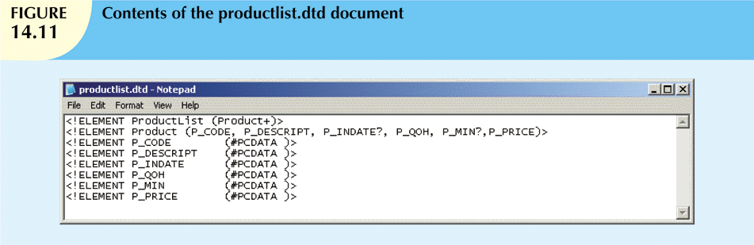
Database Systems, 9th Edition

Slide 39
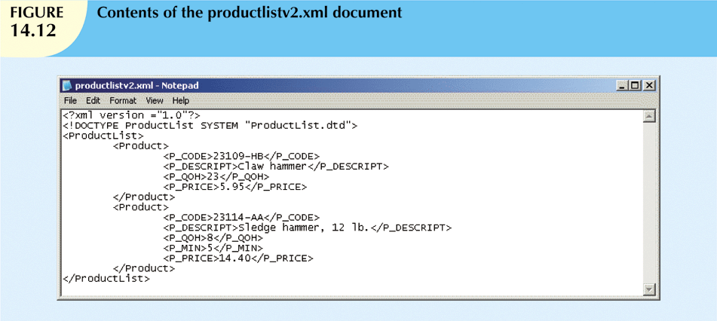
Database Systems, 9th Edition

Slide 40
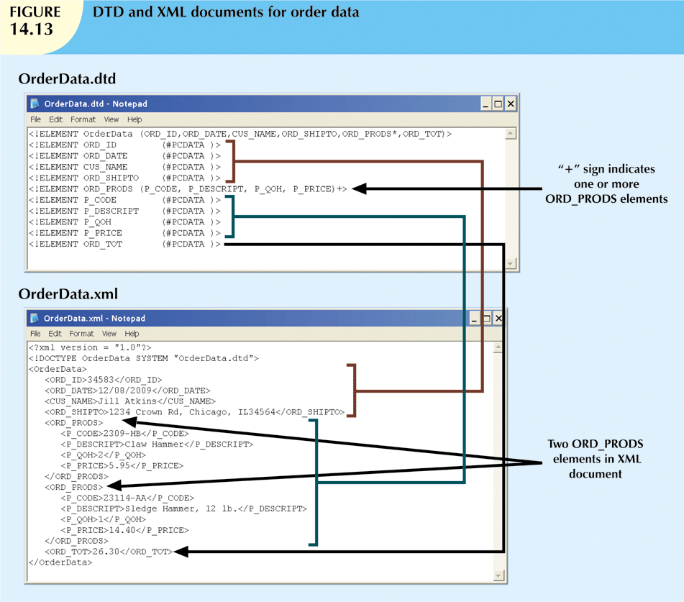
Database Systems, 9th Edition

Slide 41
Document Type Definitions (DTD) and XML Schemas (cont’d.)
XML schema
  Advanced data definition language
  Describes the structure of XML data documents
Advantage of XML schema:
  More closely maps to database terminology and features
XML schema definition (XSD) file uses syntax similar to XML document
Database Systems, 9th Edition

Slide 42
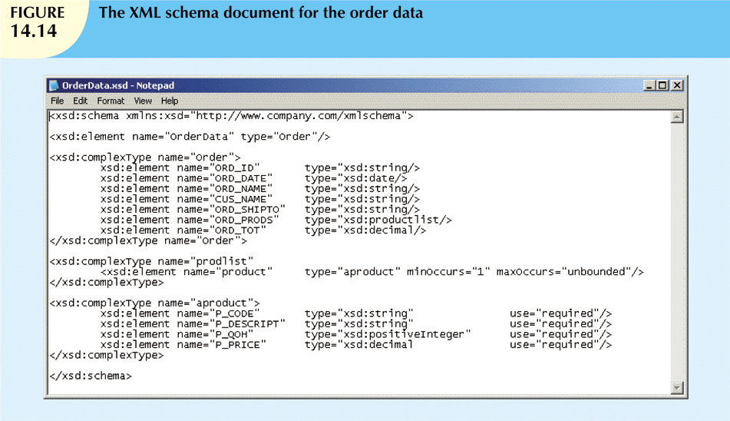
Database Systems, 9th Edition

Slide 43
XML Presentation
XML separates data structure from presentation and processing
Extensible Style Language (XSL) displays XML data
  Defines the rules by which XML data are formatted and displayed
  Two parts:
    Extensible Style Language Transformations (XSLT)
    XSL style sheets
Database Systems, 9th Edition

Slide 44
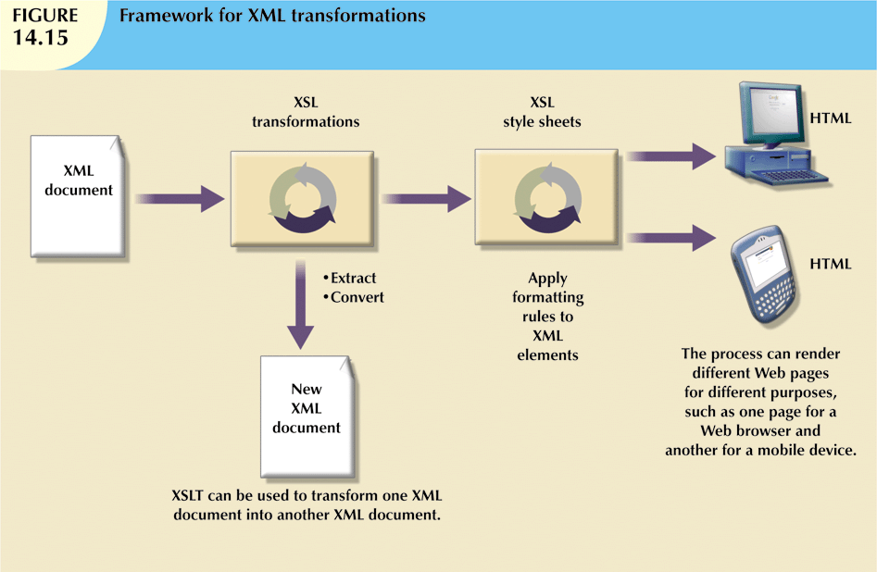
Database Systems, 9th Edition

Slide 45
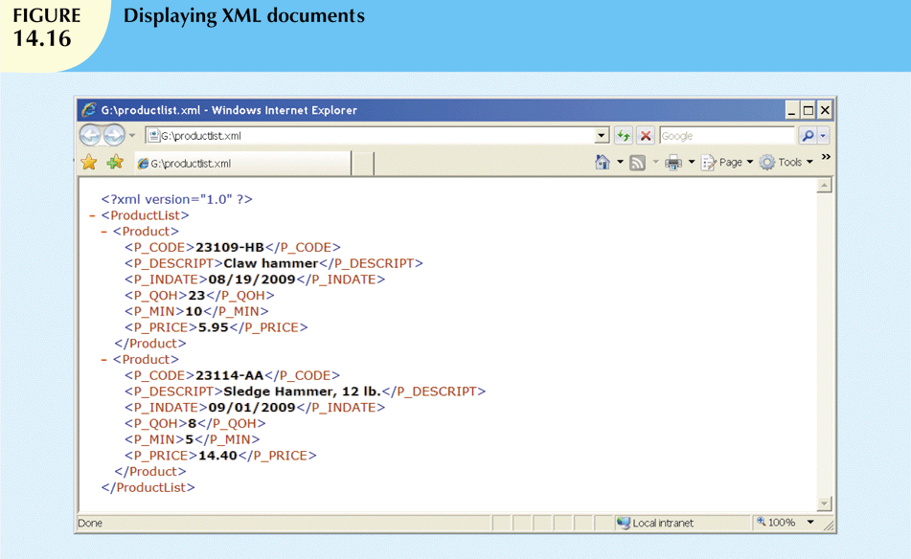
Database Systems, 9th Edition

Slide 46
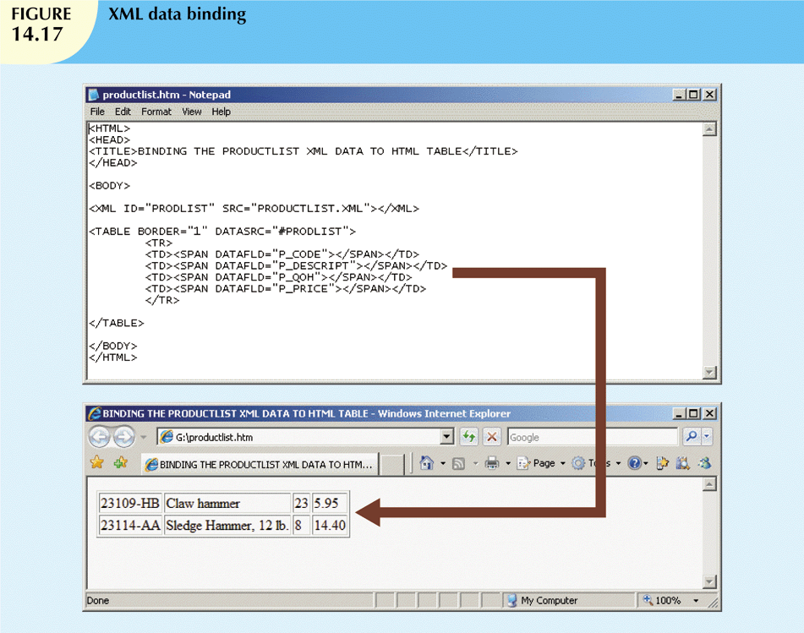
Database Systems, 9th Edition

Slide 47
XML Applications
B2B exchanges
Legacy systems integration
Web page development
Database support
Database meta-dictionaries
XML databases
XML services
Database Systems, 9th Edition

Slide 48
SQL Data Services
Provides relational data management to companies of any size
Avoids high cost of personnel/maintenance
Leverages Internet to provide:
  Hosted data management
  Standard protocols
  A common programming interface
Could assist businesses with limited information technology resources
Database Systems, 9th Edition

Slide 49
Summary
Database connectivity:
  Ways in which programs connect and communicate with data repositories
Database connectivity software known as database middleware
Database repository also known as data source
  Represents data management application used to store data generated by the program
Microsoft interfaces are dominant players
  ODBC, OLE-DB, ADO.NET
Database Systems, 9th Edition

Slide 50
Summary (cont’d.)
Microsoft’s Universal Data Access (UDA) architecture
  Collection of technologies to access any type of data source using common interface
Native database connectivity: interface provided by database vendor
  ODBC is Microsoft's implementation of SQL Access Group Call Level Interface
    Allows any Windows application to access relational data sources using SQL
Database Systems, 9th Edition

Slide 51
Summary (cont’d.)
OLE-DB adds object-oriented functionality for access to data
ActiveX Data Objects provide interface with OLE-DB, DAO, and RDO
ADO.NET is data access component of Microsoft .NET framework
Java Database Connectivity (JDBC) interfaces with Java applications with data sources
Database Systems, 9th Edition

Slide 52
Summary (cont’d.)
Database access through the Web uses middleware
On client side of Web browser, use plug-ins, Java and JavaScript, ActiveX, and VBScript
On server side, middleware expands functionality of Web servers
  Links them to wide range of services
XML provides semantics to share structured documents across the Web
  Produces description and representation of data
Database Systems, 9th Edition

